Slide 1

Web scraping to gain company insights
28/07/2023

Slide 2
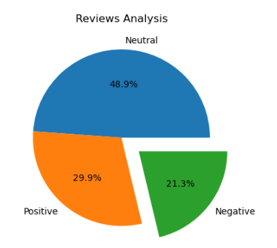
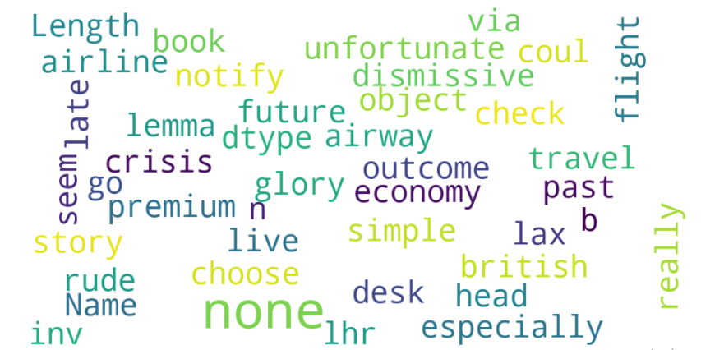
INSIGHTS FROM CUSTOMER REVIEWS
From cleaning 3611 reviews given by the customers, we obtained
Positive Reviews - 1079
Negative Reviews - 768
Neutral Reviews – 1764
Word cloud of keywords used in reviews

